Slide 1
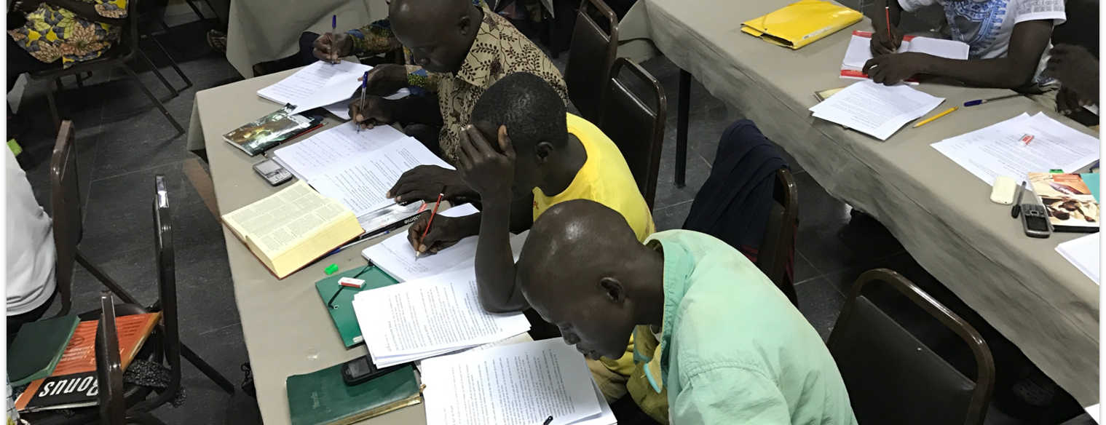
Church Owned Bible Translation
For I did not hold back from declaring to you the whole will of God. Therefore be careful about yourselves, and about all the flock of which the Holy Spirit has appointed you overseers. Be careful to shepherd the church of God, which he purchased with his own blood (Acts 20:27-28).
All Scripture taken from the English Unlocked Literal Bible (ULB), ©2017, 2022 Wycliffe Associates, Available at https://bibleineverylanguage.org/translations, licensed under the Creative Commons Attribution-ShareAlike 4.0 International License.
The English ULB is based on the unfoldingWord® Literal Text, CC BY-SA 4.0. The original work of the unfoldingWord® Literal Text is available at https://unfoldingword.bible/ult/.
Four Beliefs

Slide 2
?
What is
“Church-Owned”
Bible Translation?

Slide 3
Romans 12:4-6a
For we have many members in one body, but not all the members have the same function. ⁵ In the same way, we who are many are one body in Christ, and are individually members of each other. ⁶ We have different gifts according to the grace that was given to us.
2 Timothy 2:7
Think about what I am saying, for the Lord will give you understanding in everything.

Slide 4
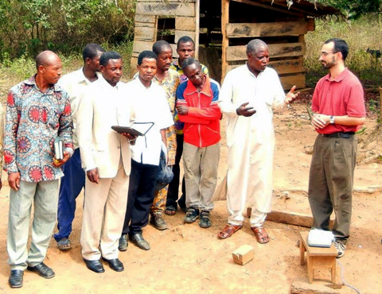
Ability
Local believers:
Know the language and culture
Have shared meaning through oral translation
Have unique, God-given abilities

Slide 5
Matthew 28:18-20
Jesus came to them and spoke to them and said, "All authority has been given to me in heaven and on earth. ¹⁹ Go therefore and make disciples of all the nations. Baptize them into the name of the Father, of the Son, and of the Holy Spirit. ²⁰ Teach them to obey all the things that I have commanded you. See, I am with you always, even to the end of the age."
Acts 1:8
But you will receive power when the Holy Spirit comes upon you, and you will be my witnesses both in Jerusalem and in all Judea and Samaria, and to the ends of the earth."

Slide 6
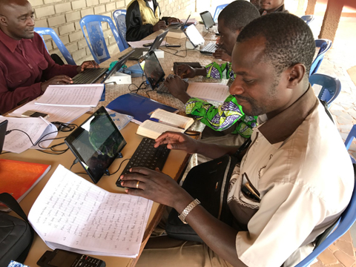
Ability
Authority
God’s Spirit gives
the local church:
Wisdom
Authority

Slide 7
1 Peter 3:15
Instead, set apart the Lord Christ in your hearts as holy. Always be ready to give an account to anyone who asks about the hope you have
Colossians 3:16
Let the word of Christ live in you richly, teaching and instructing one another with all wisdom, singing psalms and hymns and spiritual songs with thankfulness in your hearts to God.
2 Timothy 2:2
The things you heard from me among many witnesses, entrust them to faithful people who will be able to teach others also.

Slide 8
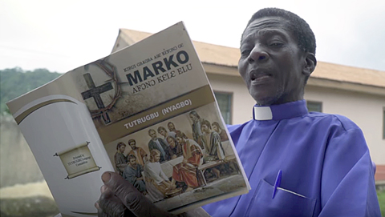
Ability
Authority
Responsibility
The local church
is responsible for:
Evangelism
Discipleship
Bible Translation

Slide 9
Romans 14:12
So then, each one of us will give an account of himself to God.
1 Corinthians 2:12-13
But we did not receive the spirit of the world but the Spirit who is from God, so that we might know the things freely given to us by God. ¹³ We speak about these things in words not taught by human wisdom but by the Spirit, interpreting spiritual things to spiritual people.

Slide 10
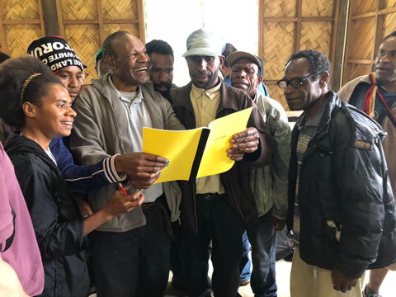
Ability
Authority
Responsibility
Translators are accountable to:
God
Their community
Accountability

